Slide 1
DHCP SERVICE

Slide 2
In this section, we will discuss
DHCP Service
What is DHCP and DHCP Server ?
Why is DHCP important ?
IP Address allocation mechanism of DHCP
Benefits of DHCP

Slide 3
What is DHCP and DHCP server?
DHCP – Dynamic Host Configuration Protocol is a network management protocol that we use on TCP/IP network. The DHCP server, automatically assigns IP addresses and other network configurations like subnet mask, default gateway, DNS server, and more to the connected devices so they can exchange information.

Slide 4
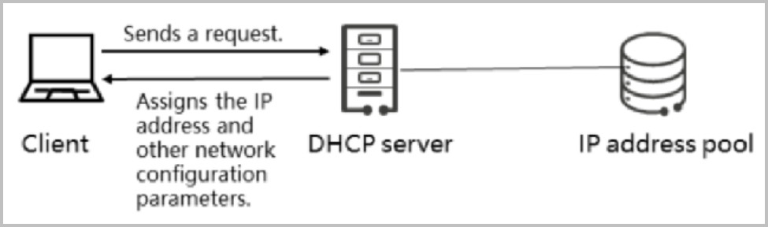
Why is DHCP important?
DHCP is important because it makes it really easy for network administrators to provide IP addresses to client devices on the network. It manages the pool of IP addresses automatically.
Using this protocol, the network administrators, don’t need to set a static IP for each device, and later reassign it to another and keep an eye on all the available IPs. They will just set up the DHCP server with all the additional network information, and it will do its work dynamically.

Slide 5
IP address allocation mechanisms of DHCP
There are three ways that you can configure the DHCP server:
Automatic allocation. This one will automatically assign an IP per client permanently. The IP address will be designated for just one device, so if, in the future, many new devices get connected, the server could run out of IP addresses to give.
Dynamic allocation. This is the most common configuration. The server auto-assigns IP addresses to clients, but there is a time period. After the time expires, the client needs to ask for a new IP address again. This will prevent the running out of IPs.
Manual allocation. Manually the network administrator will assign the IP address to the client.

Slide 6
Benefits of DHCP
Reduced network administration time and costs.
Increased Security.
More Efficient use of Ip addresses.
Automatic allocation of Ip addresses.
Easy to use and manage.

Slide 7
PROXY SERVER

Slide 8
In this section, we will discuss
Proxy Server
What is Proxy Server ?
Work of Proxy Server
Use of Proxy Server
Types of Proxy Server
Benefits of Proxy Server

Slide 9
What is Proxy Server ?
A Proxy Server is Software System running on a computer that acts as :
An end user , such as computer
An internet server hosting resources like web pages, files, videos.
Proxy means: Representing someone , acting on behalf of someone.

Slide 10
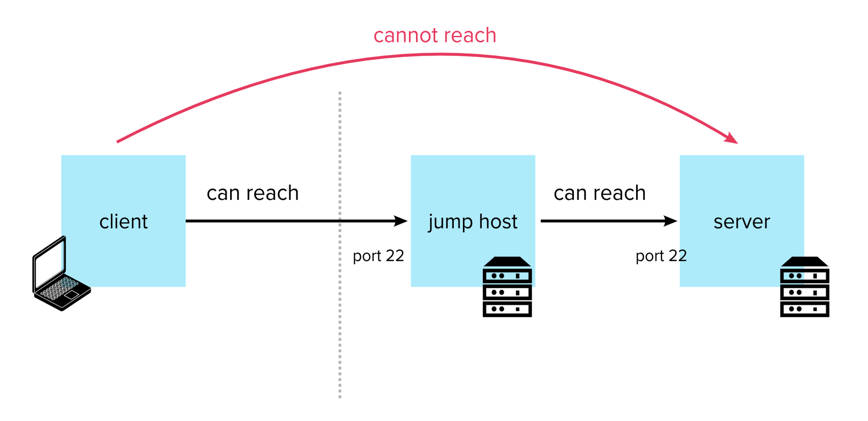
Work of proxy server

Slide 11
Uses of proxy server
Hide your Ip address.
Blocking Website browser.
Speed
Activity logging
Access Control
Security

Slide 12
Types of proxy server
HTTP Proxy
Socks Proxy
Transparent Proxy

Slide 13
Benefits of Proxy Server
It improves the security and enhances the privacy of the user.
It hides the identity (IP address) of the user.
Also, saves bandwidth by caching files and compressing incoming traffic.
Protect our network from malware.
Allows access to the restricted content.

Slide 14
Remote Access Service

Slide 15
In this section, we will discuss
Remote Access Service
What is Remote Access Service ?
How to work Remote Access Server ?
Use of Remote Access Software
Remote Access Software List

Slide 16
What is Remote Access Service
Remote Access software allows one computer to remotely access and control another computer through the network This software enables the user to connect two or more computers present at the different networks and locations.

Slide 17

How to Work Remote Access Server ?

Slide 18
Use of Remote Access Software
Troubleshooting
Work from home
Help Desk
Personal Use

Slide 19
Remote Access Software List
Team Viewer
AnyDesk

Slide 20
Thank You

